Slide 1
Classification: Basic Concepts and Decision Trees
Notes:
‹#›

Slide 2
Classification: Definition
Given a collection of records (training set )
Each record contains a set of attributes, one of the attributes is the class.
Find a model for class attribute as a function of the values of other attributes.
Goal: previously unseen records should be assigned a class as accurately as possible.
A test set is used to determine the accuracy of the model. Usually, the given data set is divided into training and test sets, with training set used to build the model and test set used to validate it.
Notes:
‹#›

Slide 3
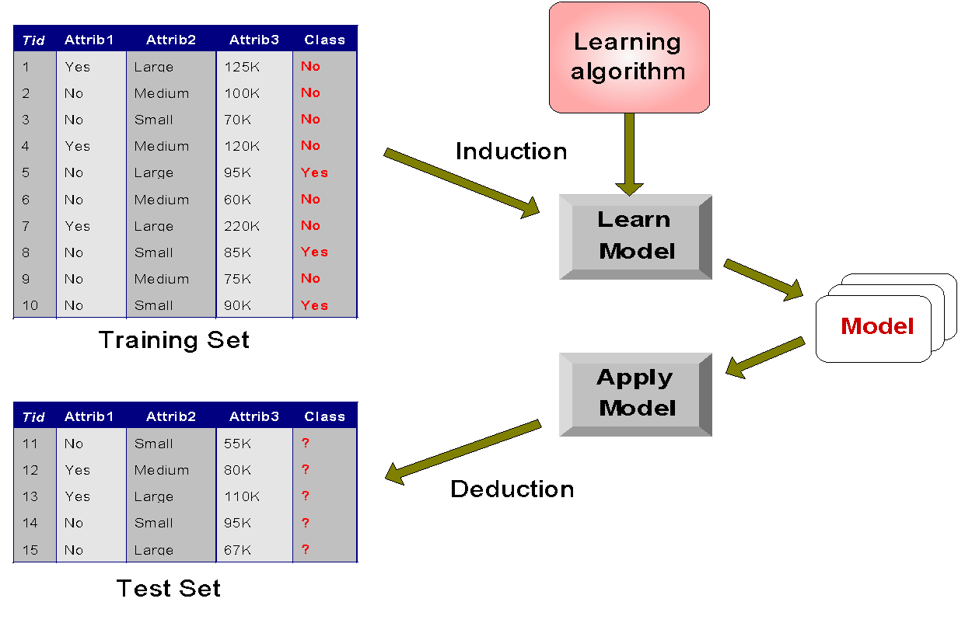
Illustrating Classification Task

Slide 4

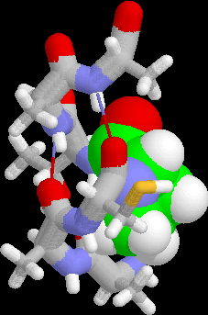


Examples of Classification Task
Predicting tumor cells as benign or malignant
Classifying credit card transactions as legitimate or fraudulent
Classifying secondary structures of protein as alpha-helix, beta-sheet, or random coil
Categorizing news stories as finance, weather, entertainment, sports, etc

Slide 5
Classification Vs. Clustering
Classification = Supervised Learning
The training data (observations, measurements, etc.) are accompanied by labels indicating the class of the observations
New data is classified based on the training set
Clustering = Unsupervised Learning
The class labels of training data is unknown
Given a set of measurements, observations, etc. with the aim of establishing the existence of classes or clusters in the data

Slide 6
Classification Techniques
Decision Tree
Neural Networks
Naïve Bayes
Bayesian Belief Networks
Support Vector Machines
Lazy Learners etc

Slide 7
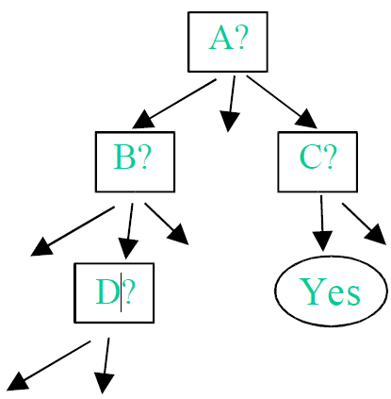
Decision Tree for Classification
Widely-used method of constructing a model from a dataset
In the form of a decision tree or a set of decision rules. It is
Often claimed that this representation of the data has the advantage compared with other approaches of being meaningful and easy to interpret.

Slide 8
Decision Tree for Classification
A decision tree
Internal node denotes a test on an attribute
Branch denotes the outcome of the test
Leaf node holds the class level
The top most is the root node
Internal nodes are represented by rectangles and leaf nodes by ovals
For a tuple X (class unknown),
the attribute values are tested against the tree
The path traced from root to leaf holds the class prediction for the tuple
Can be found the classification rules

Slide 9
Decision Tree for Classification
Why popular
The construction decision tree needs no domain knowledge
Can handle multi dimensional data
Easy to assimilate by humans
Learning is simple and fast
Good accuracy (in general).
Many applications such as medicine, manufacturing, production, financial analysis, astronomy, molecular biology

Slide 10
Decision Tree Induction : Generation
Tree construction
At start, all training examples at the root
Partition examples based on selected attributes
Test attributes are selected based on a heuristic or a statistical measure
Tree pruning
Identify or remove branches that reflects noise or outliers

Slide 11
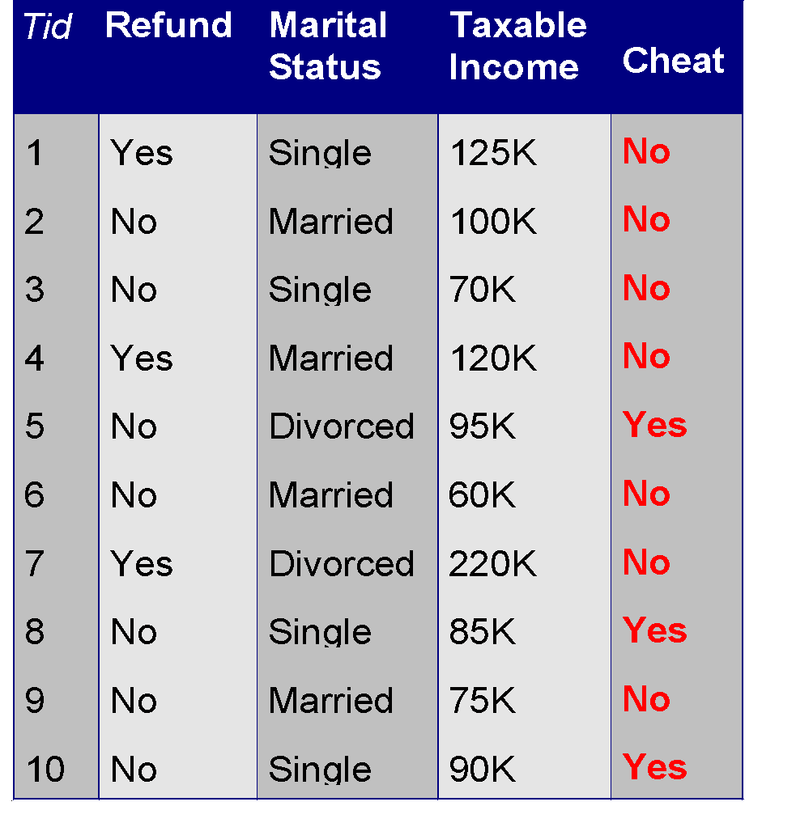
Example of a Decision Tree
categorical
categorical
continuous
class
Splitting Attributes
Refund
Yes
No
NO
MarSt
Single, Divorced
Married
TaxInc
NO
< 80K
> 80K
NO
YES
Training Data
Model: Decision Tree

Slide 12
Another Example of Decision Tree
categorical
categorical
continuous
class
MarSt
Single, Divorced
Married
NO
Refund
Yes
No
NO
TaxInc
< 80K
> 80K
NO
YES
There could be more than one tree that fits the same data!

Slide 13

Decision Tree Classification Task
Decision Tree

Slide 14
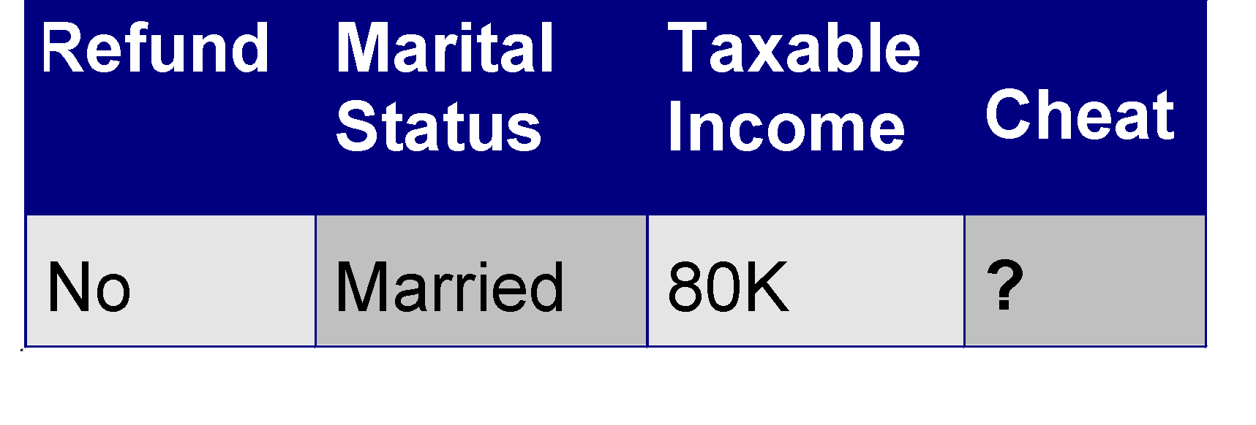
Apply Model to Test Data
Test Data
Start from the root of tree.
Refund
Yes
No
NO
MarSt
Single, Divorced
Married
TaxInc
NO
< 80K
> 80K
NO
YES

Slide 15
Apply Model to Test Data
Test Data
Refund
Yes
No
NO
MarSt
Single, Divorced
Married
TaxInc
NO
< 80K
> 80K
NO
YES

Slide 16
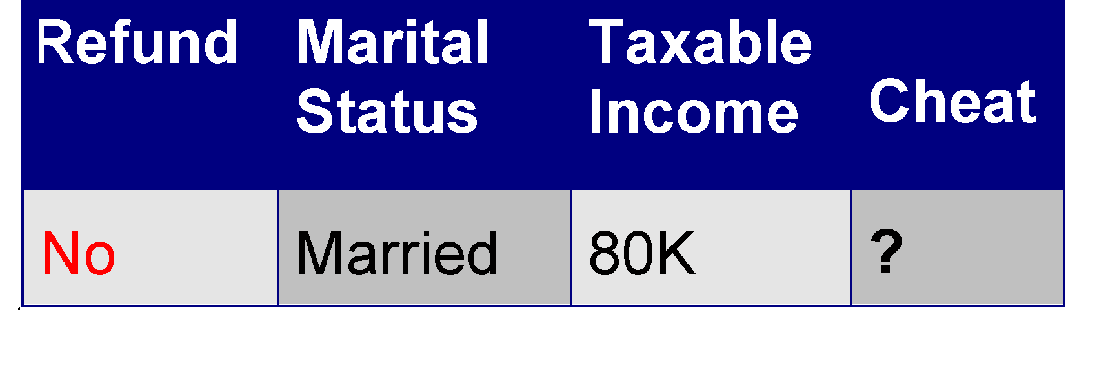
Apply Model to Test Data
Test Data
Refund
Yes
No
NO
MarSt
Single, Divorced
Married
TaxInc
NO
< 80K
> 80K
NO
YES

Slide 17
Apply Model to Test Data
Test Data
Refund
Yes
No
NO
MarSt
Single, Divorced
Married
TaxInc
NO
< 80K
> 80K
NO
YES

Slide 18
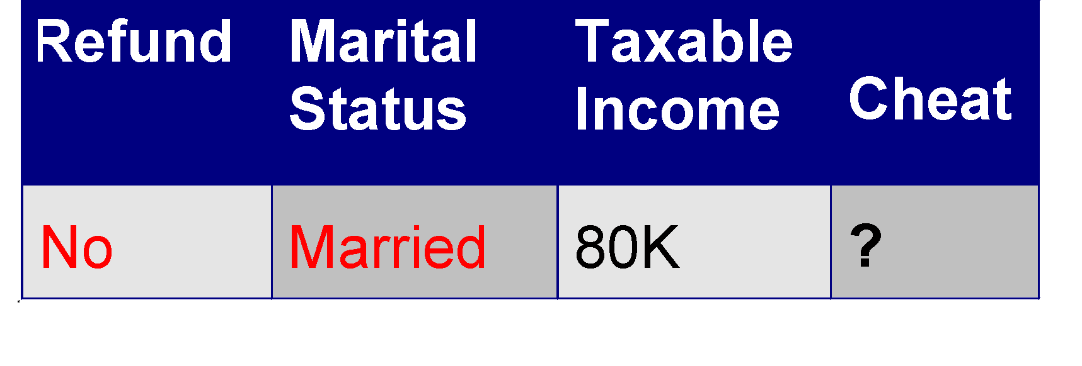
Apply Model to Test Data
Test Data
Refund
Yes
No
NO
MarSt
Single, Divorced
Married
TaxInc
NO
< 80K
> 80K
NO
YES

Slide 19
Apply Model to Test Data
Test Data
Refund
Yes
No
NO
MarSt
Single, Divorced
Married
Assign Cheat to “No”
TaxInc
NO
< 80K
> 80K
NO
YES

Slide 20
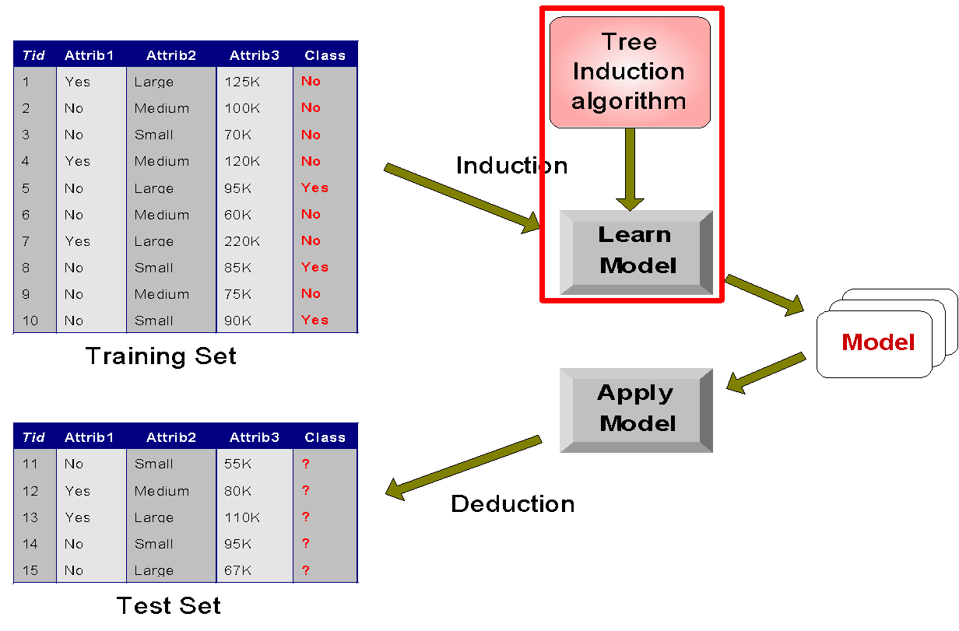
Decision Tree Classification Task
Decision Tree

Slide 21
Decision Tree Induction
Many Algorithms:
Hunt’s Algorithm (one of the earliest)
CART
ID3, C4.5
SLIQ,SPRINT

Slide 22
Algorithm for Decision Tree Induction
Basic algorithm (a greedy algorithm)
Tree is constructed in a top-down recursive divide-and-conquer manner
At start, all the training examples are at the root
Attributes are categorical (if continuous-valued, they are discretized in advance)
Examples are partitioned recursively based on selected attributes
Test attributes are selected on the basis of a heuristic or statistical measure (e.g., information gain)

Slide 23
Algorithm for Decision Tree Induction
Conditions for stopping partitioning
All samples for a given node belong to the same class
There are no remaining attributes for further partitioning – majority voting is employed for classifying the leaf
There are no samples left
Many variants
ID3 , CHAID , CART , C4.5

Slide 24
Tree Induction
Greedy strategy.
Split the records based on an attribute test that optimizes certain criterion.
Issues
Determine how to split the records
How to specify the attribute test condition?
How to determine the best split?
Determine when to stop splitting

Slide 25
Tree Induction
Greedy strategy.
Split the records based on an attribute test that optimizes certain criterion.
Issues
Determine how to split the records
How to specify the attribute test condition?
How to determine the best split?
Determine when to stop splitting

Slide 26
How to Specify Test Condition?
Depends on attribute types
Categorical
Continuous
Depends on number of ways to split
2-way split
Multi-way split

Slide 27
Splitting Based on Categorical Attributes
Multi-way split: Use as many partitions as distinct values.
Binary split: Divides values into two subsets. Need to find optimal partitioning.
What about this split?
Size
Small
Large
Medium
Size
Size
{Small, Medium}
OR
{Medium, Large}
{Large}
{Small}
Size
{Small, Large}
{Medium}

Slide 28
Splitting Based on Continuous Attributes
Different ways of handling
Discretization to form an ordinal categorical attribute
Static – discretize once at the beginning
Dynamic – ranges can be found by equal interval bucketing, equal frequency bucketing (percentiles), or clustering.
Binary Decision:
consider all possible splits and finds the best cut
can be more compute intensive

Slide 29
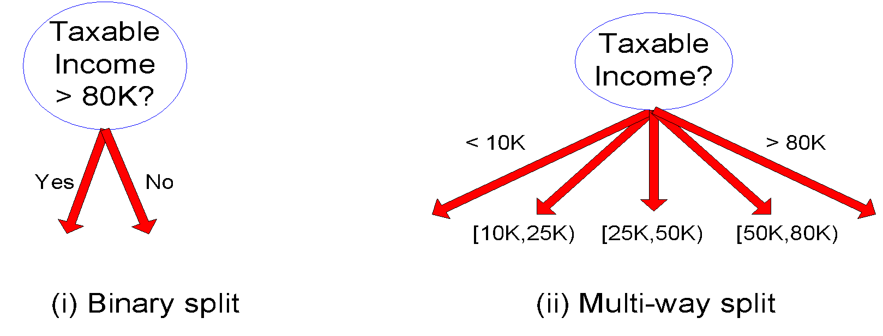
Splitting Based on Continuous Attributes

Slide 30
Tree Induction
Greedy strategy.
Split the records based on an attribute test that optimizes certain criterion.
Issues
Determine how to split the records
How to specify the attribute test condition?
How to determine the best split?
Determine when to stop splitting

Slide 31
Attribute Selection Measure
Information Gain
Gain Ratio
Gini Index

Slide 32
Attribute Selection Measure
Information gain (ID3/C4.5)
All attributes are assumed to be categorical
Can be modified for continuous-valued attributes
Gini index (IBM IntelligentMiner)
All attributes are assumed continuous-valued
Assume there exist several possible split values for each attribute
May need other tools, such as clustering, to get the possible split values
Can be modified for categorical attributes
Chapter 6
‹#›

Slide 33
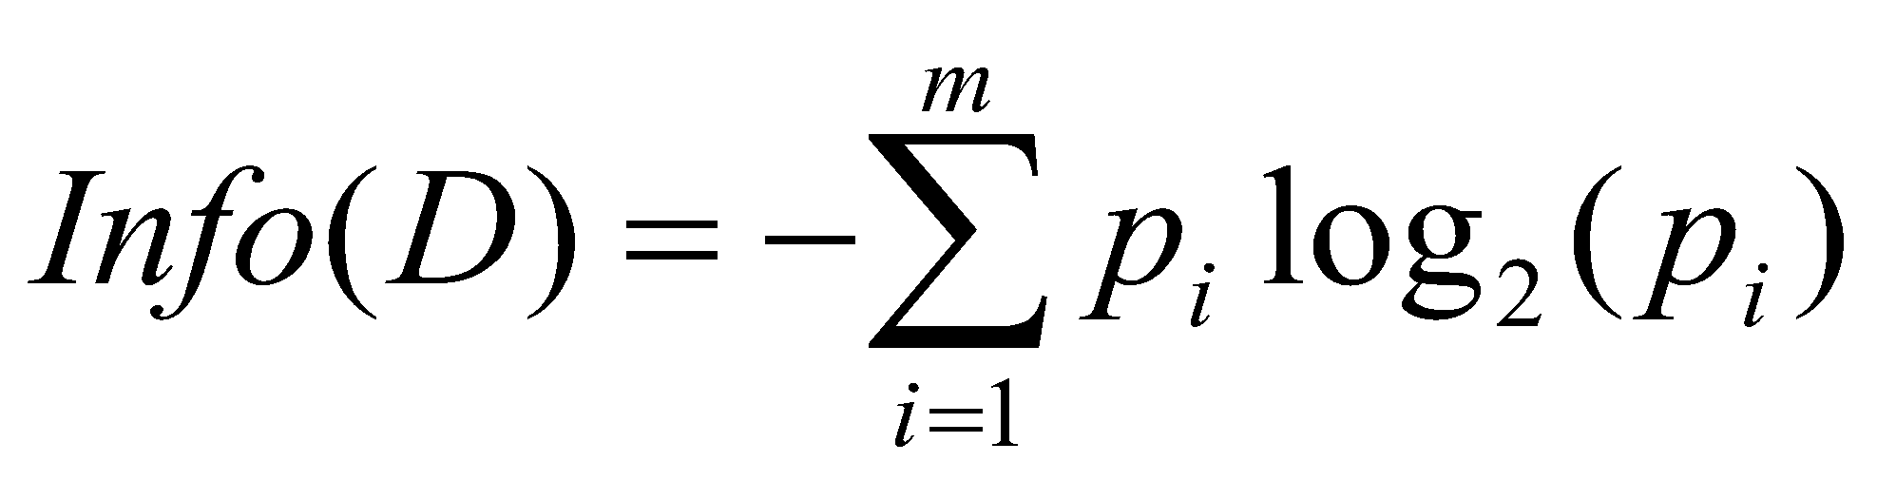
Attribute Selection Measure: Information Gain (ID3/C4.5)
Select the attribute with the highest information gain
Expected information (entropy) needed to classify a tuple in D:
p_{i} = the number of occurrences of class i divided by the total number of instances
i = 1…k
M= Number of class
‹#›
Notes:
‹#›

Slide 34
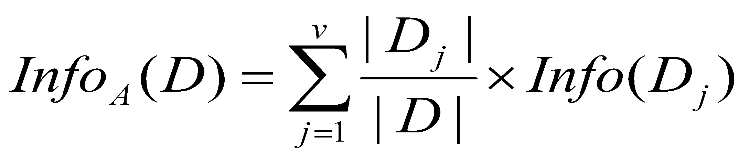
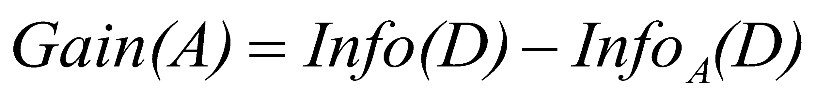
Attribute Selection Measure: Information Gain (ID3/C4.5)
Information needed (after using A to split D into v partitions) to classify D:
Information gained by branching on attribute A
‹#›
Notes:
‹#›

Slide 35
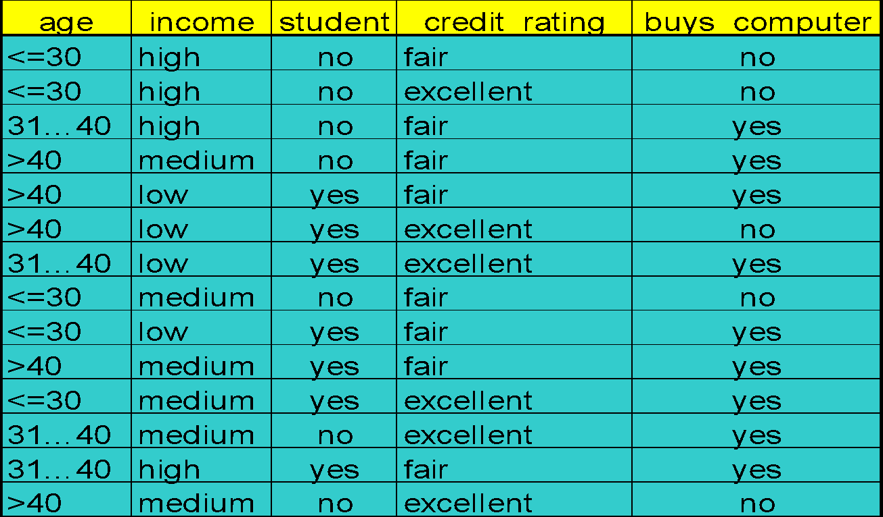
Training Set for buys_computer Example

Slide 36
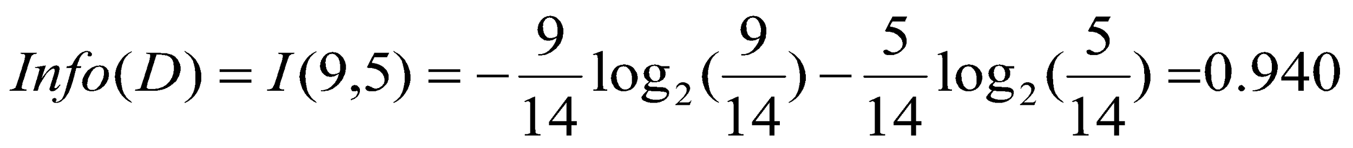
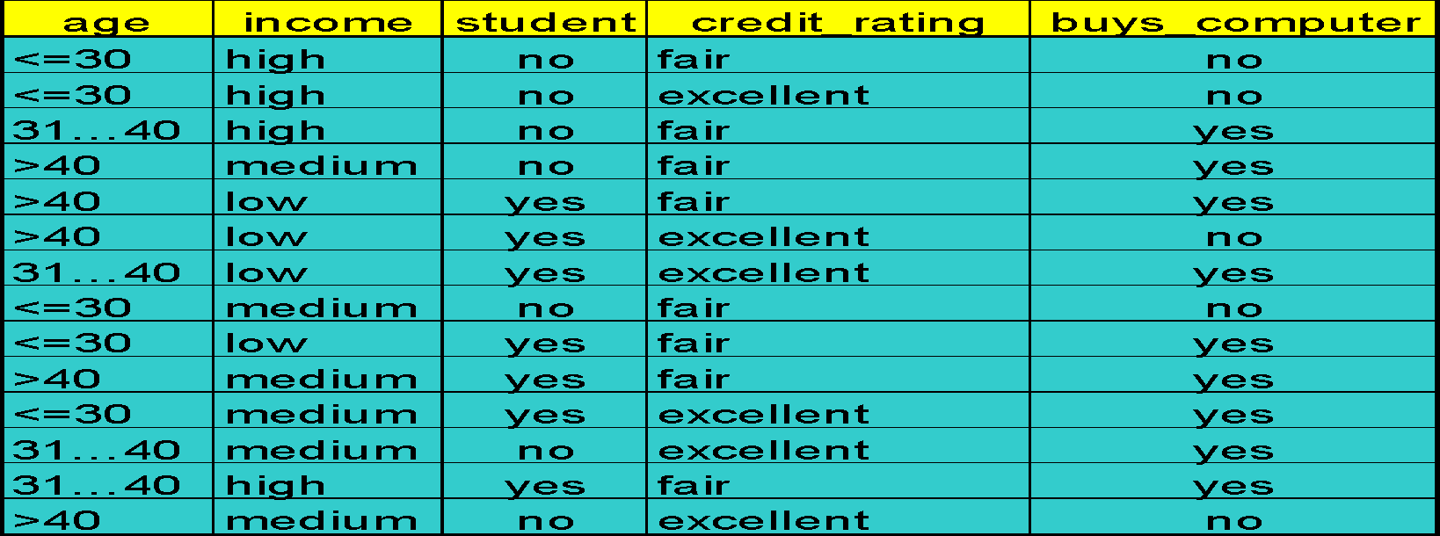
Attribute Selection : Information Gain

Slide 37
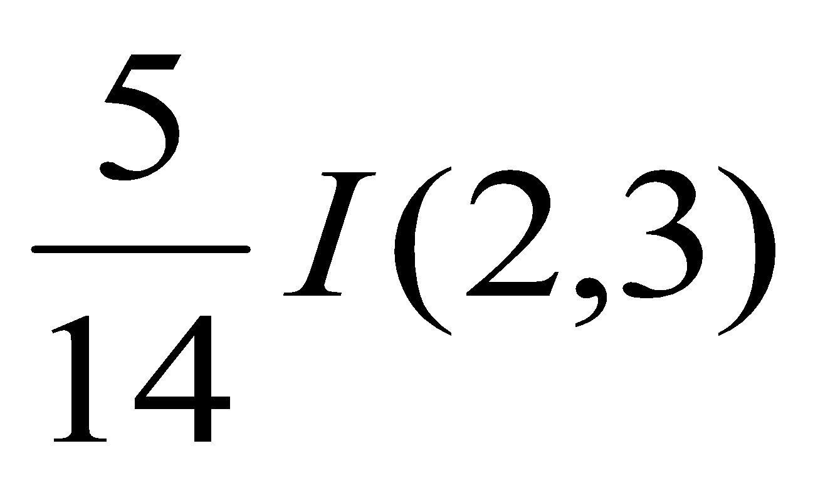
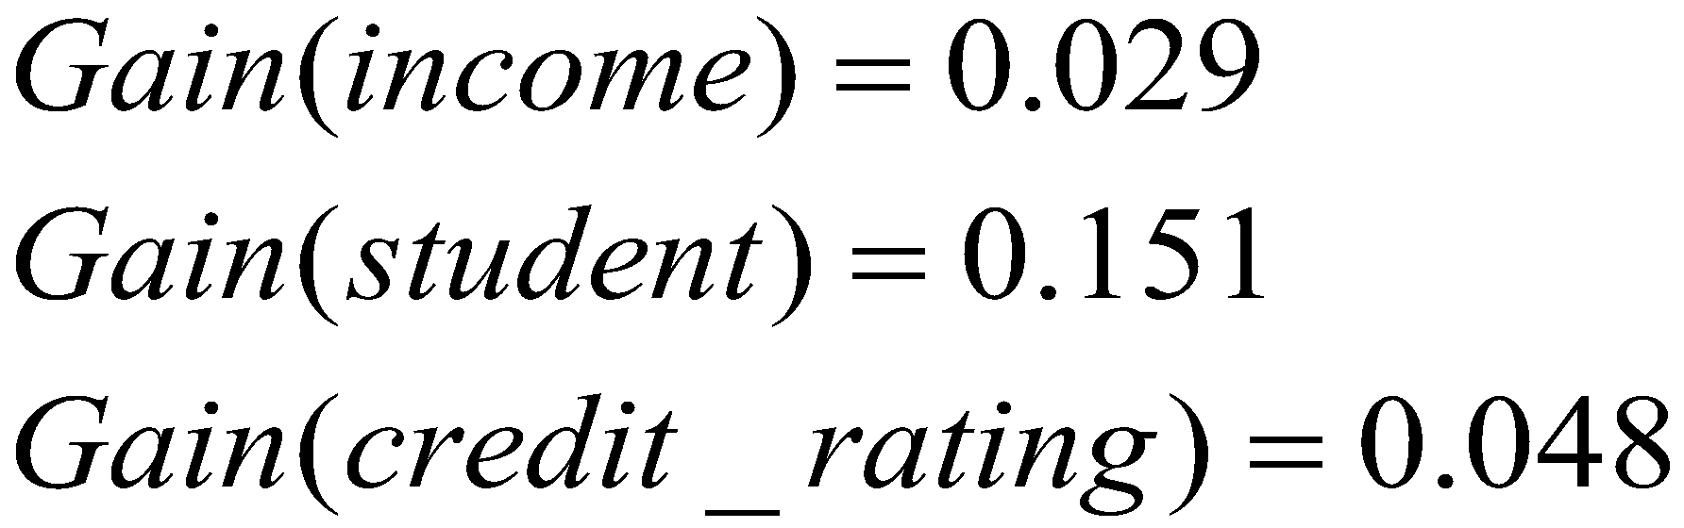
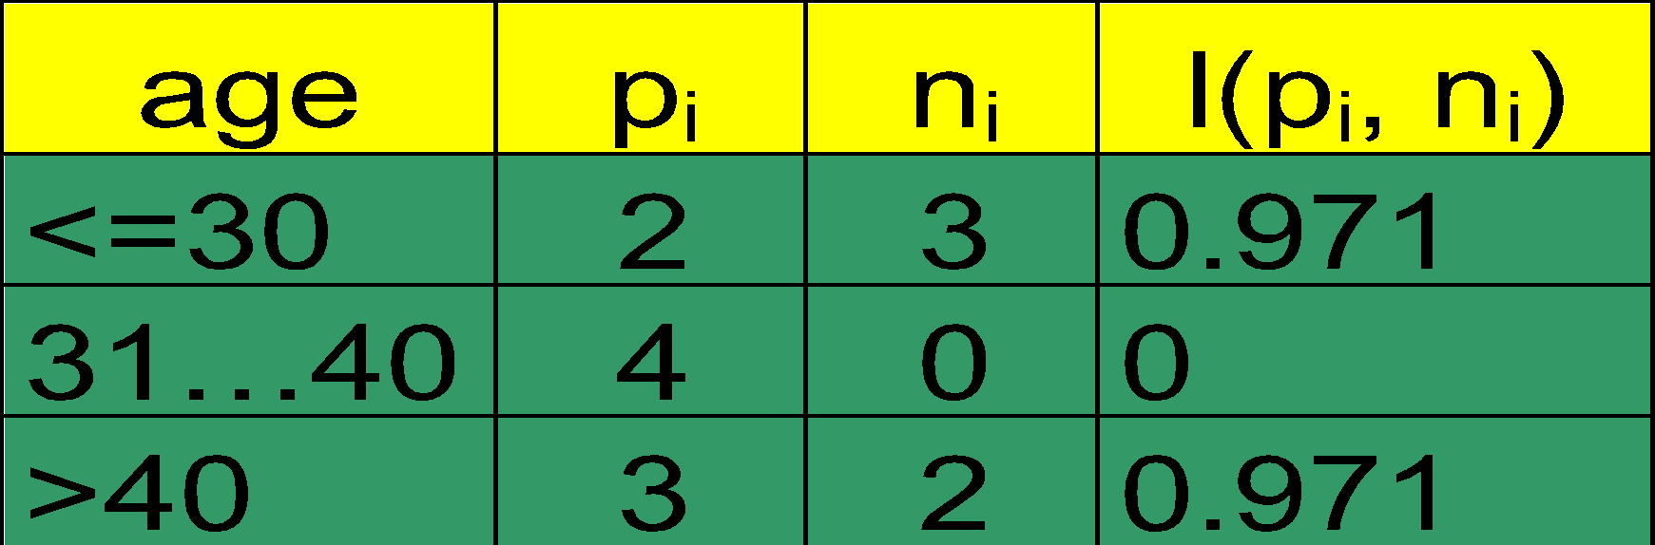
Attribute Selection: Information Gain
means “age <=30” has 5 out of 14 samples, with 2 yes’es and 3 no’s.
Similarly,
‹#›

Slide 38
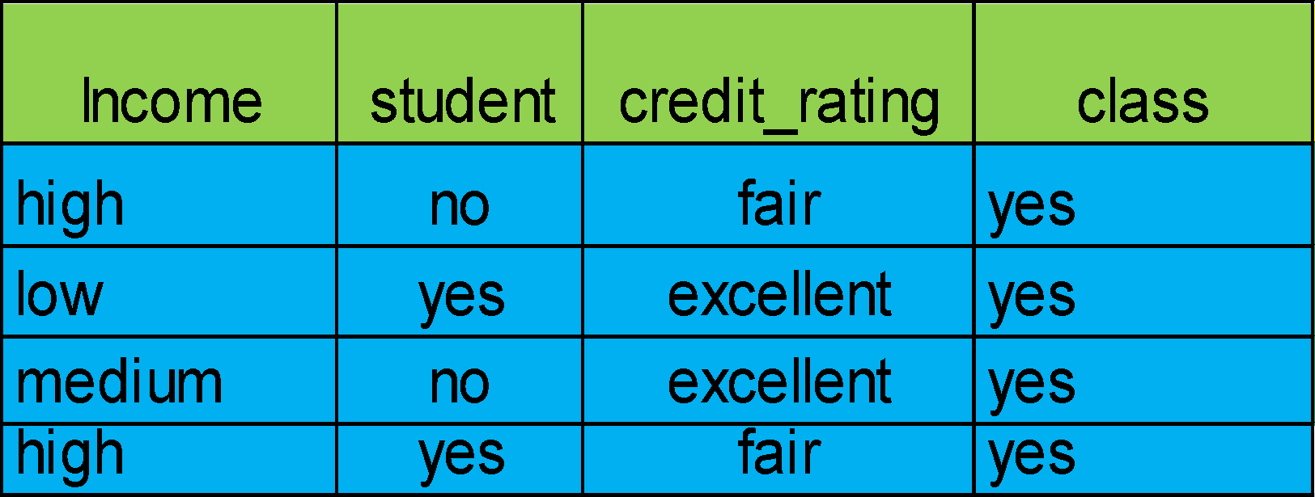
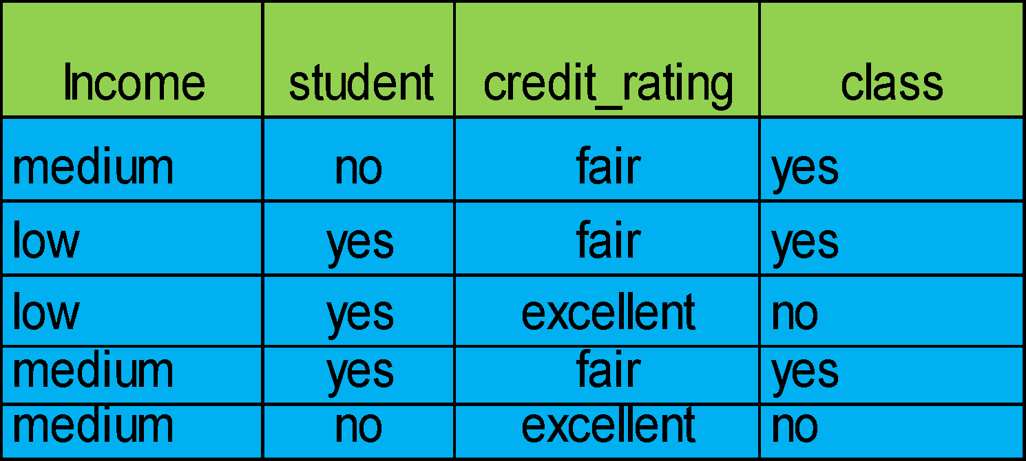
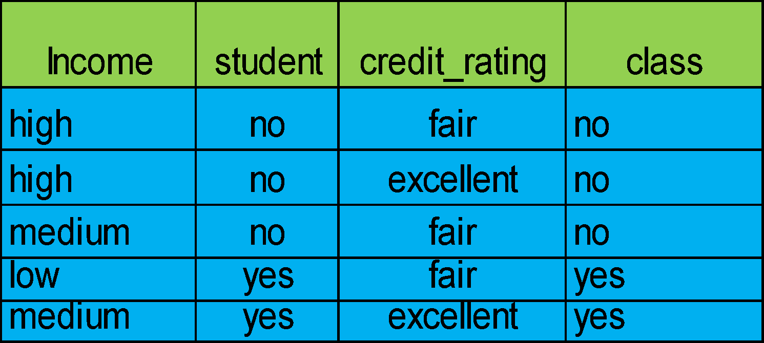
Attribute Selection : Information Gain
Age?
>40
<=30
31…40

Slide 39
Output: A Decision Tree for “buys_computer”
age?
<=30
overcast
>40
31..40
student?
yes
credit rating?
no
yes
fair
excellent
no
yes
no
yes
*
Data Mining: Concepts and Techniques
‹#›

Slide 40
Attribute Selection : Information Gain
(Continuous Valued Attribute)
Let attribute A be a continuous-valued attribute
Must determine the best split point for A
Sort the value A in increasing order
Typically, the midpoint between each pair of adjacent values is considered as a possible split point
(a_{i}+a_{i+1})/2 is the midpoint between the values of a_{i} and a_{i+1}
The point with the minimum expected information requirement for A is selected as the split-point for A
Split:
D1 is the set of tuples in D satisfying A ≤ split-point, and D2 is the set of tuples in D satisfying A > split-point

Slide 41
Extracting Classification Rules from Trees
Represent the knowledge in the form of IF-THEN rules
One rule is created for each path from the root to a leaf
Each attribute-value pair along a path forms a conjunction
The leaf node holds the class prediction
Rules are easier for humans to understand
Chapter 6
‹#›

Slide 42
IF age = “<=30” AND student = “no” THEN buys_computer = “no”
IF age = “<=30” AND student = “yes” THEN buys_computer = “yes”
IF age = “31…40” THEN buys_computer = “yes”
IF age = “>40” AND credit_rating = “excellent” THEN buys_computer = “yes”
IF age = “<=30” AND credit_rating = “fair” THEN buys_computer = “no”
age?
<=30
>40
30..40
student?
yes
credit rating?
no
yes
excellent
fair
no
yes
no
yes
‹#›

Slide 43
Training Examples
Day
Outlook
Temp.
Humidity
Wind
Play Tennis
D1
Sunny
Hot
High
Weak
No
D2
Sunny
Hot
High
Strong
No
D3
Overcast
Hot
High
Weak
Yes
D4
Rain
Mild
High
Weak
Yes
D5
Rain
Cool
Normal
Weak
Yes
D6
Rain
Cool
Normal
Strong
No
D7
Overcast
Cool
Normal
Weak
Yes
D8
Sunny
Mild
High
Weak
No
D9
Sunny
Cold
Normal
Weak
Yes
D10
Rain
Mild
Normal
Strong
Yes
D11
Sunny
Mild
Normal
Strong
Yes
D12
Overcast
Mild
High
Strong
Yes
D13
Overcast
Hot
Normal
Weak
Yes
D14
Rain
Mild
High
Strong
No
‹#›

Slide 44
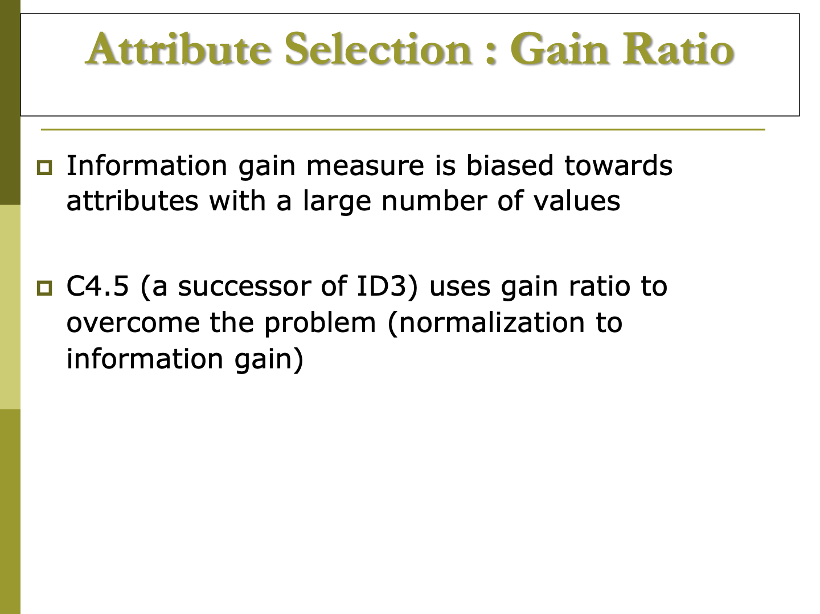

Slide 45
